Slide 1

Be Prepared
Numbers
Dr. Rick Griffith • Crossroads International Church Singapore
CICFamily.com • BibleStudyDownloads.org

Slide 2
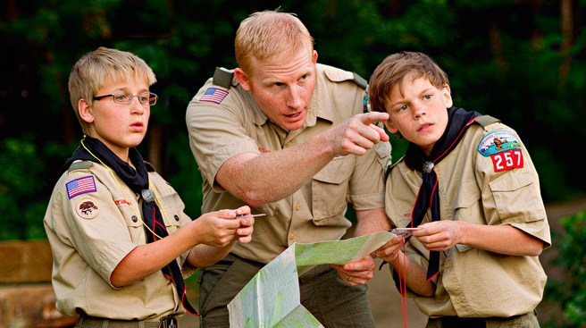
Boy Scouts

Slide 3

Be Prepared

Slide 4
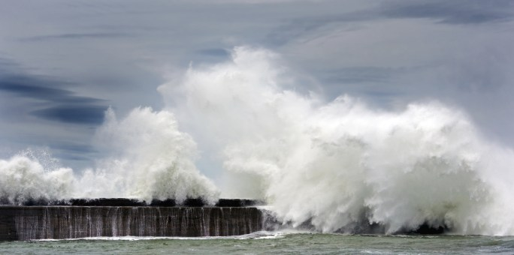
How would you prepare for a Hurricane?

Slide 5
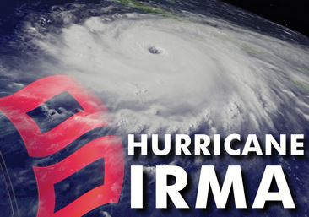
Be Prepared

Slide 6
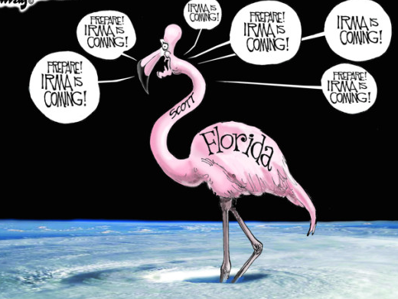
Irma

Slide 7
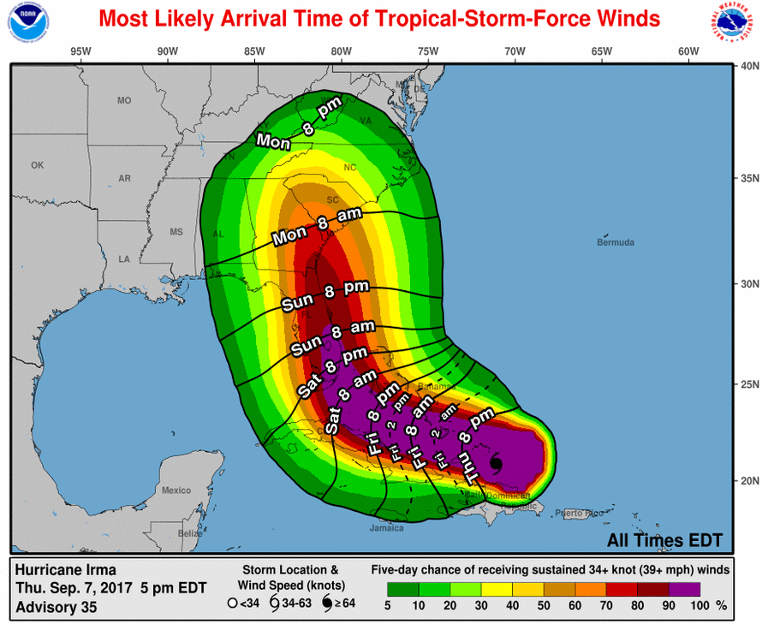
Irma

Slide 8
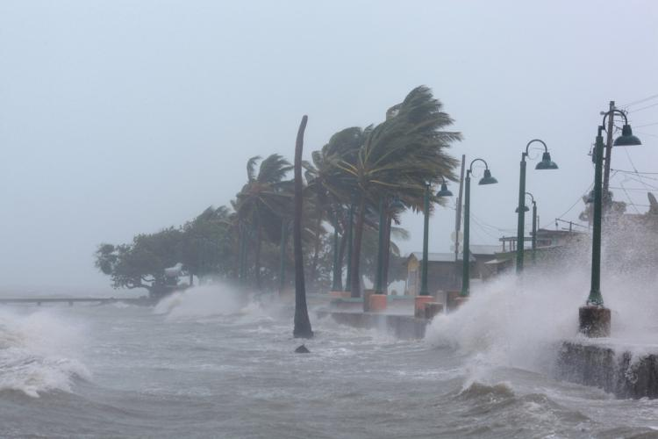
Irma

Slide 9
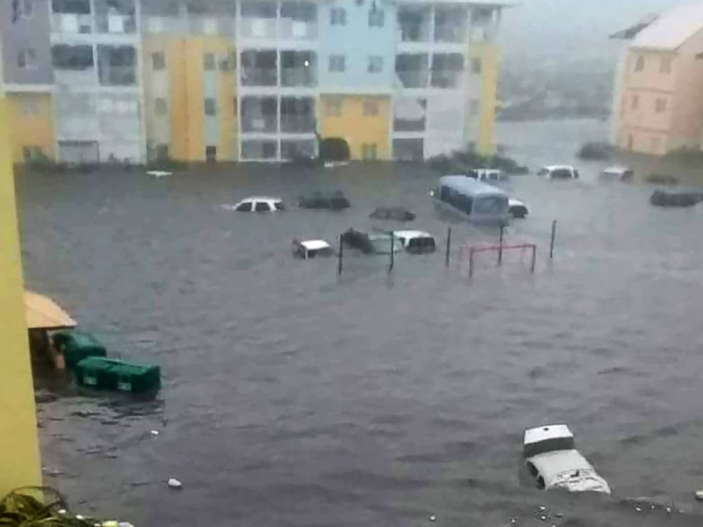
Irma
Cars sit on a flooded street on the island of Saint-Martin after Irma

Slide 10
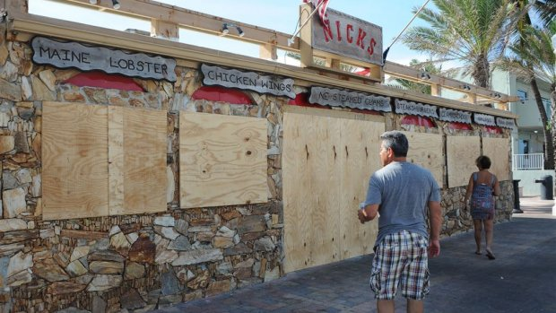
Be Prepared

Slide 11

How does God prepare us to serve him?
3 ways
Numbers
Notes:
In what ways does the Lord work in us so we can work for him?

Slide 12
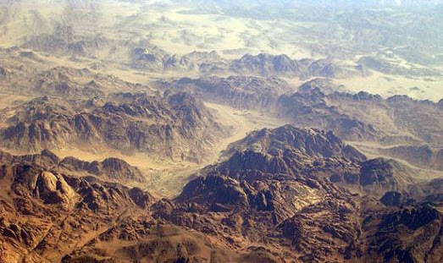
Numbers
Preparation to Possess the Land
Dr. Rick Griffith • Jordan Evangelical Theological Seminary • BibleStudyDownloads.org
Notes:
As we begin Numbers, Israel has been at Sinai for a year now. The people have received deliverance from Egypt and received a charter for living, including the priesthood and tabernacle system—plus they know from Leviticus how to live in a holy manner for the LORD to remain among them.

Slide 13

Time When Numbers Starts
Exodus
Numbers
April 1445
May 1444
Feb
Apri l
June
Aug
Oct
D e c
Feb
Apri l
June

Slide 14
Time When Numbers Ends
May 1444
Sept
1405
39 years
1445
1440
1435
1430
1425
1 4 2 0
1415
1410
1405

Slide 15

Map Preceding Numbers
• Zoan
• Rameses
Kadesh- Barnea
GOSHEN
• Marah
• Elim
Desert of Sin
Midian
• Rephidim
Mt. Sinai
Route of the Exodus

Slide 16
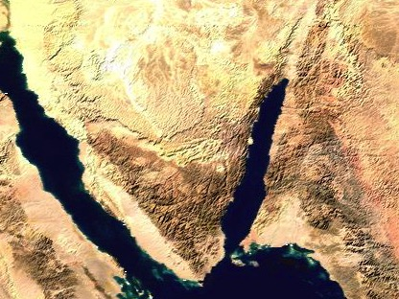
Geographical Start of Numbers
• Marah
• Elim
Midian
Desert of Sin
• Rephidim
Mt. Sinai

Slide 17
Geographical End of Numbers
Moab
Kadesh- barnea
Mt. Hor
Mt. Sinai

Slide 18
Numbers
135
Preparation to Occupy the Land
Preparing the
Old Generation
Postponement
for Unbelief
Preparing the
New Generation
1:1–10:10
10:11–25:18
26–36
God's Faithfulness
Israel's Faithlessness
God's Faithfulness
God's Blessings
God's Discipline
God's Blessings
Israel's Commitment
Israel's Complaining
Israel's Commitment
Order
Disorder
Reorder
Mount Sinai
Wilderness
Moab
20 Days
38 Years, 3 Months, 10 Days
ca. 5 Months
Organization
(1–4)
Sanctification (5:1–10:10)
To Kadesh (10:11–
12:16)
Kadesh Sin
(13–14)
Wilder-ness (15–19)
To Moab (20–21)
Moab
Sin
(22–25)
Provision for Land (26–27)
Offerings & Vows (28–30)
Final Preparations (31–36)

Slide 19
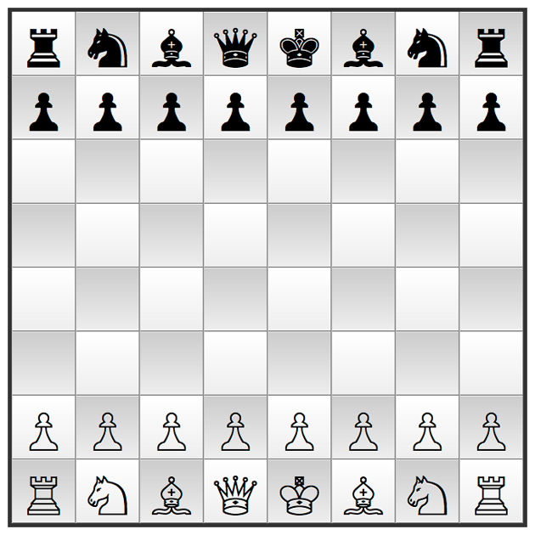
Key Word
135
Preparation

Slide 20
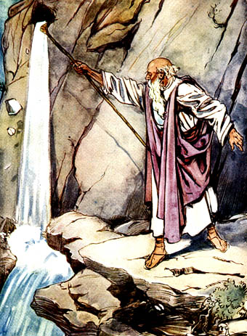
Water from a Rock
1 Corinthians 10:1-13 (NIV)

Slide 21

Numbers gives wisdom
". . . from infancy you have known the holy Scriptures, which are able to make you wise for salvation through faith in Christ Jesus."
2 Timothy 3:15 (NIV)

Slide 22
Numbers teaches & encourages
"For everything that was written in the past was written to teach us, so that through endurance and the encouragement of the Scriptures we might have hope."
Romans 15:4 (NIV)

Slide 23
Birth of a People
Exodus
Leviticus
Numbers
Joshua
Them
Formation
Sanctification
Preparation
Possession
Us
Salvation
Instruction
Walk
Rest
Notes:
The theme of each of these four books parallels our Christian experience today.
Exodus: God formed a people by delivering them in the Exodus; He also saved believers today from the slavery of sin.
Leviticus: God taught Israel as saved people to live a holy life; likewise, he teaches us how to live pure lives today.
Numbers: God prepared Israel to rule Canaan and does the same for believers today (cf. 1 Cor 6:1-2).
Joshua: As God rewarded Israel's faith with their own land, so he will bless Christians to rest with Israel in the millennium (Hebrews 4).
——————
OS-02-Exodus-30
OS-03-Leviticus-23
OS-04-Numbers-23
OS-06-Joshua-6
OS-07-Judges-2

Slide 24
Summary Statement
135
God's faithful preparation
of His people to enter Canaan
contrasts with
Israel's unbelieving rebelliousness in the wilderness
to teach the nation His unconditional commitment
to fulfill His Abrahamic Covenant.

Slide 25
How does God prepare us to serve him?
3 ways
Numbers
Notes:
In what ways does the Lord work in us so we can work for him?

Slide 26

I. God organizes us to be holy.
Numbers 1:1–10:10
Notes:
The LORD sets us apart by arranging us.

Slide 27
Slides on
Numbers 1

Slide 28
Numbers
135
Preparation to Occupy the Land
Preparing the
Old Generation
Postponement
for Unbelief
Preparing the
New Generation
1:1–10:10
10:11–25:18
26–36
God's Faithfulness
Israel's Faithlessness
God's Faithfulness
God's Blessings
God's Discipline
God's Blessings
Israel's Commitment
Israel's Complaining
Israel's Commitment
Order
Disorder
Reorder
Mount Sinai
Wilderness
Moab
20 Days
38 Years, 3 Months, 10 Days
ca. 5 Months
Organization
(1–4)
Sanctification (5:1–10:10)
To Kadesh (10:11–
12:16)
Kadesh Sin
(13–14)
Wilder-ness (15–19)
To Moab (20–21)
Moab
Sin
(22–25)
Provision for Land (26–27)
Offerings & Vows (28–30)
Final Preparations (31–36)

Slide 29
Slides on
Numbers 2

Slide 30
Population Changes in the Wilderness
140
Tribe | Num. 1 (1444 BC) Start of Wanderings | Num. 26 (1406 BC) End of Wanderings | Increase (Decrease)
Reuben | 46,500 | 43,730 | (2,770)
Simeon | 59,300 | 22,200 | (37,100)
Gad | 45,650 | 40,500 | (5,150)
Judah | 74,600 | 76,500 | 1,900
Isaachar | 54,400 | 64,300 | 9,900
Zebulun | 57,400 | 60,500 | 3,100
Ephraim | 40,500 | 32,500 | (8,000)
Manasseh | 32,200 | 52,700 | 20,500
Benjamin | 35,400 | 45,600 | 10,200
Dan | 62,700 | 64,400 | 1,700
Asher | 41,500 | 53,400 | 11,900
Naphtali | 53,400 | 45,400 | (8,000)
Total | 603,550 | 601,730 | (1,820)
Levi | 22,000 | 23,000 | 1,000

Slide 31
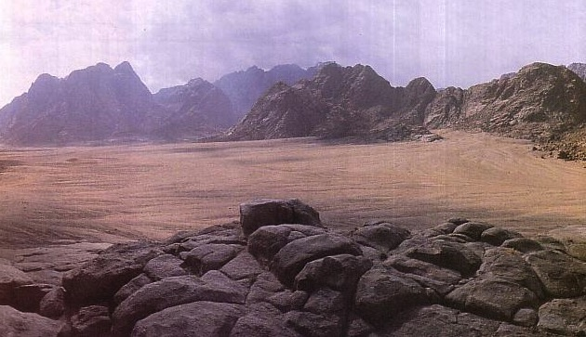
Where did Israel fit 2 million people?
Mt. Sinai had the Plain of Rafah to the north which was large enough for all Israel to camp.

Slide 32

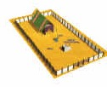
Tribes Encircled the Tabernacle
142
N
Naphtali
W
E
Asher
Dan
S
Ephraim
Manasseh
Judah
Benjamin
Issachar
Zebulun
Gad
Simeon
Reuben
Numbers 2

Slide 33

Populations
Naphtali Asher
Dan
157,400
142
N
W
E
S
Ephraim Manasseh Benjamin 108,100
Judah Issachar Zebulun 186,400
Gad Simeon Reuben 151,450
Numbers 2

Slide 34

A Cross Formation!
142
Naphtali Asher
Dan
157,400
N
W
E
S
Judah Issachar Zebulun 186,400
Ephraim Manasseh Benjamin 108,100
Gad Simeon Reuben 151,450
Numbers 2

Slide 35
Slides on
Numbers 3

Slide 36
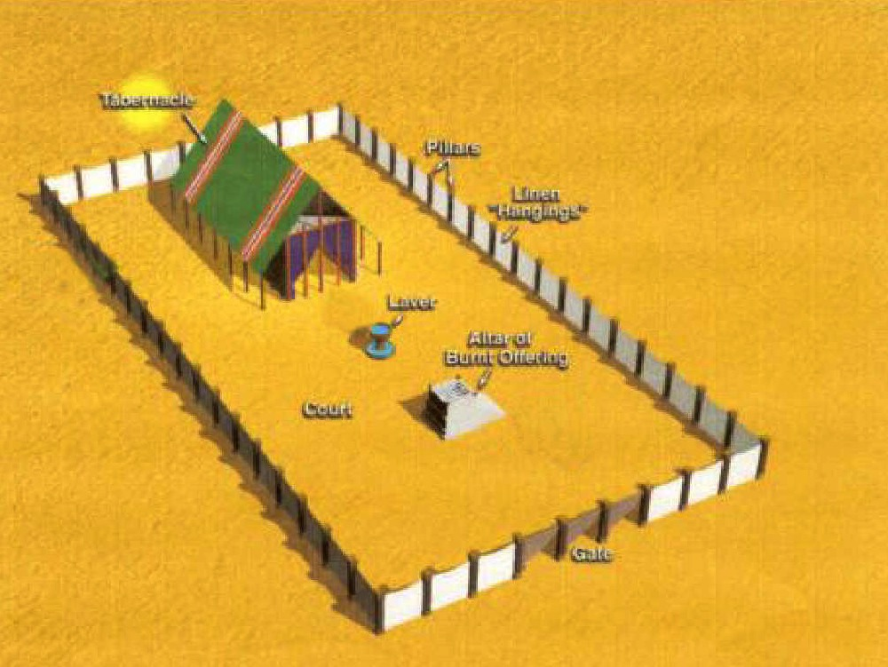
Levite & Priest Tents
Gershonites
142
N
7,500
W
E
S
Merarites
6,200
Kohathites
Moses & Aaron and sons
8,600
Numbers 3

Slide 37
Levi's Family Tree
132
Levi's Family Tree
LEVI
Gershon
Kohath
Merari
Levites
Amram
Priests
High Priest
Miriam
Aaron
Moses
Offered
Unauthorised Fire;
Killed by God
Nadab
Abihu
Eleazar
Ithamar
Adapted from Manna Bible Maps
Manna

Slide 38
Slides on
Numbers 4

Slide 39
Putting it together…
142
N
W
E
Benjamin
Dan
Asher
S
Naphtali
Gershonites
Manasseh
Merarites
Ephraim
Kohathites
Judah
Moses & Aaron and sons
Issachar
Gad
Simeon
Zebulun
Reuben
Numbers 4

Slide 40
Slides on
Numbers 5

Slide 41
Numbers
135
Preparation to Occupy the Land
Preparing the
Old Generation
Postponement
for Unbelief
Preparing the
New Generation
1:1–10:10
10:11–25:18
26–36
God's Faithfulness
Israel's Faithlessness
God's Faithfulness
God's Blessings
God's Discipline
God's Blessings
Israel's Commitment
Israel's Complaining
Israel's Commitment
Order
Disorder
Reorder
Mount Sinai
Wilderness
Moab
20 Days
38 Years, 3 Months, 10 Days
ca. 5 Months
Organization
(1–4)
Sanctification (5:1–10:10)
To Kadesh (10:11–
12:16)
Kadesh Sin
(13–14)
Wilder-ness (15–19)
To Moab (20–21)
Moab
Sin
(22–25)
Provision for Land (26–27)
Offerings & Vows (28–30)
Final Preparations (31–36)

Slide 42
Slides on
Numbers 6

Slide 43


The
LORD
Bless you
and keep you;
The LORD make His face shine upon you,
And be gracious to you;
The LORD lift His countenance upon you,
And give you peace.
Numbers 6:24-26

Slide 44
Slides on
Numbers 7

Slide 45

Numbers 7:12
"Now the one who presented his offering on the first day was Nahshon…"

Slide 46
Slides on
Numbers 8

Slide 47
Slides on
Numbers 9

Slide 48

Follow God’s directions instead of your own way to order your life.
Notes:
Death came to defiant believers in the OT, so discipline at least this severe would come to rejecting the Christ they knew (10:28-31).

Slide 49

Be organized.

Slide 50

Be organized.

Slide 51

God has given you all you need to serve him.

Slide 52
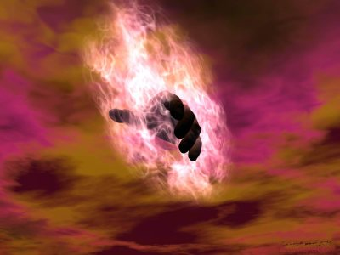
Let God work through you
(Phil 2:13 NLT)
"For God is working in you, giving you the desire and the power to do what pleases him."

Slide 53

1 Cor. 10:13 (NLT)
¹³The temptations in your life are no different from what others experience. And God is faithful. He will not allow the temptation to be more than you can stand. When you are tempted, he will show you a way out so that you can endure.

Slide 54
Philippians 4:13
I can do
EVERYTHING
through HIM
who gives me
STRENGTH
Notes:
You can mimic Jesus in any of these areas with his help.

Slide 55
Slides on
Numbers 10

Slide 56
How does God prepare us to serve him?

Slide 57
I. God organizes us to be holy.
Numbers 1:1–10:10
Notes:
The LORD sets us apart by arranging us.

Slide 58
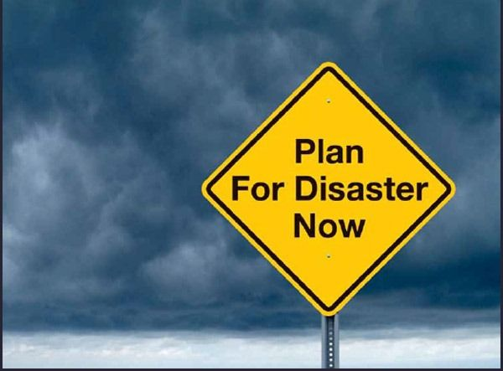
II. God warns us of the cost of unbelief.
Plan
For Disaster
Now
Numbers 10:11–25:18
Notes:
The LORD disciplines us with loss of reward.

Slide 59
Numbers
135
Preparation to Occupy the Land
Preparing the
Old Generation
Postponement
for Unbelief
Preparing the
New Generation
1:1–10:10
10:11–25:18
26–36
God's Faithfulness
Israel's Faithlessness
God's Faithfulness
God's Blessings
God's Discipline
God's Blessings
Israel's Commitment
Israel's Complaining
Israel's Commitment
Order
Disorder
Reorder
Mount Sinai
Wilderness
Moab
20 Days
38 Years, 3 Months, 10 Days
ca. 5 Months
Organization
(1–4)
Sanctification (5:1–10:10)
To Kadesh (10:11–
12:16)
Kadesh Sin
(13–14)
Wilder-ness (15–19)
To Moab (20–21)
Moab
Sin
(22–25)
Provision for Land (26–27)
Offerings & Vows (28–30)
Final Preparations (31–36)

Slide 60
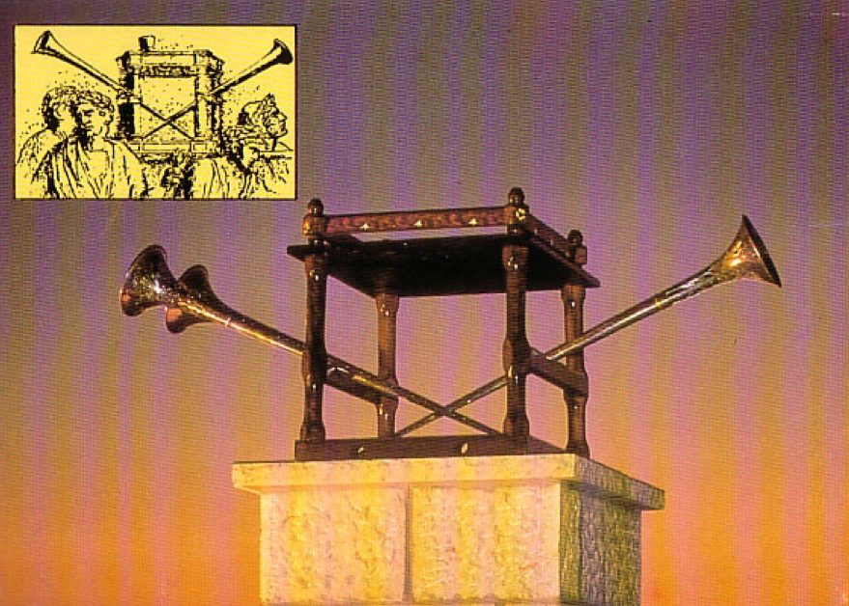
The Silver Trumpets (10:1-10)

Slide 61
Marching Orders
142
N
W
E
8
S
Dan
Asher
Naphtali
4
Gershonites
Benjamin
1
Merarites
Judah
Manasseh
3
Kohathites
Issachar
Ephraim
Moses & Aaron
and sons
7
6
Zebulun
Gad
2
Simeon
Reuben
5
Numbers 2, 10

Slide 62
The Marching Line
142
Furniture
Tabernacle
Dan
Ephraim
Reuben
Judah
Asher
Simeon
Issachar
ARK
Merarites
Manasseh
Kohathites
Gershonites
Naphtali
Benjamin
Gad
Zebulun
Numbers 2; 10:11-28

Slide 63
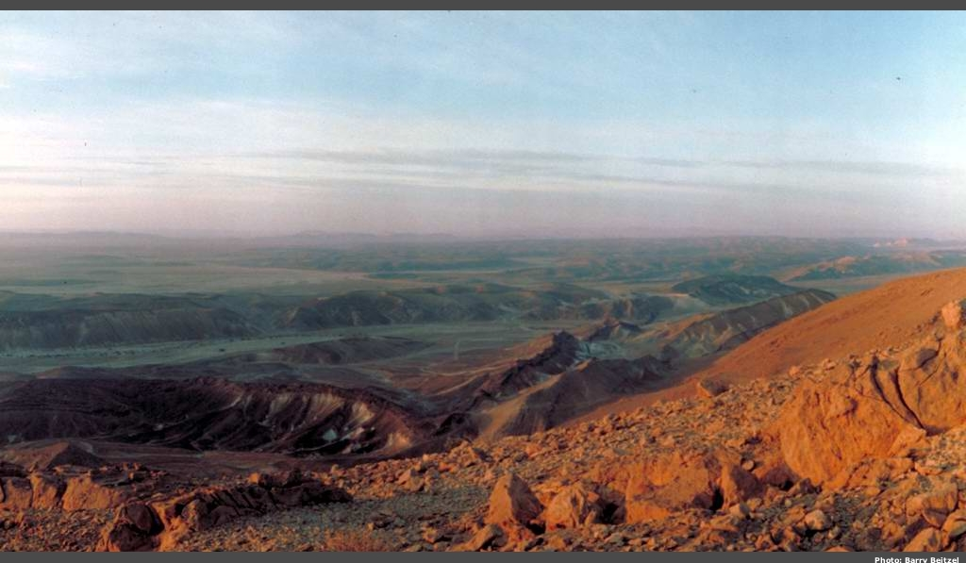
The Wilderness of Paran (10:12)

Slide 64
Slides on
Numbers 11

Slide 65
Complaining!
"Soon the people began to complain about their hardship, and the LORD heard everything they said. Then the LORD’s anger blazed against them, and he sent a fire to rage among them, and he destroyed some of the people in the outskirts of the camp. ²Then the people screamed to Moses for help, and when he prayed to the LORD, the fire stopped. ³After that, the area was known as Taberah (which means ‘the place of burning’), because fire from the LORD had burned among them there" (Num 11:1-3 NLT).

Slide 66
Slides on
Numbers 12

Slide 67
Numbers 1–12 Map
• Zoan
• Rameses
Kadesh- barnea
GOSHEN
• Marah
• Elim
Desert of Sin
• Rephidim
Mt. Sinai
Route of the Journey

Slide 68
Numbers
135
Preparation to Occupy the Land
Preparing the
Old Generation
Postponement
for Unbelief
Preparing the
New Generation
1:1–10:10
10:11–25:18
26–36
God's Faithfulness
Israel's Faithlessness
God's Faithfulness
God's Blessings
God's Discipline
God's Blessings
Israel's Commitment
Israel's Complaining
Israel's Commitment
Order
Disorder
Reorder
Mount Sinai
Wilderness
Moab
20 Days
38 Years, 3 Months, 10 Days
ca. 5 Months
Organization
(1–4)
Sanctification (5:1–10:10)
To Kadesh (10:11–
12:16)
Kadesh Sin
(13–14)
Wilder-ness (15–19)
To Moab (20–21)
Moab
Sin
(22–25)
Provision for Land (26–27)
Offerings & Vows (28–30)
Final Preparations (31–36)

Slide 69
Slides on
Numbers 13

Slide 70
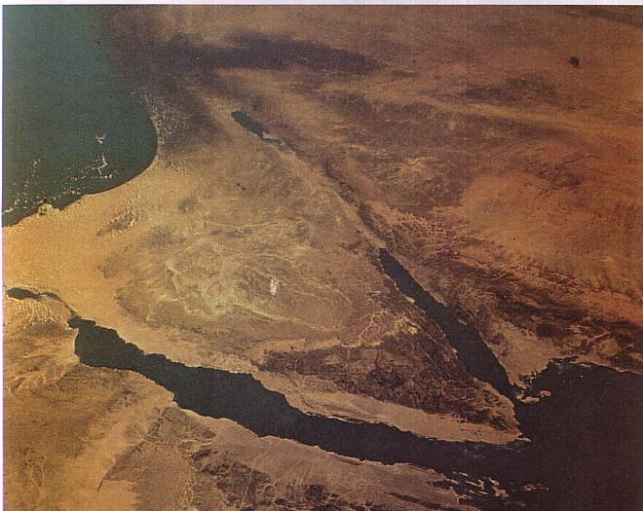
Wilderness Wanderings
The Sinai Peninsula is no picnic (especially for 40 years!)
Kadesh
Mt. Sinai

Slide 71

Kadesh Barnea (13:26)

Slide 72
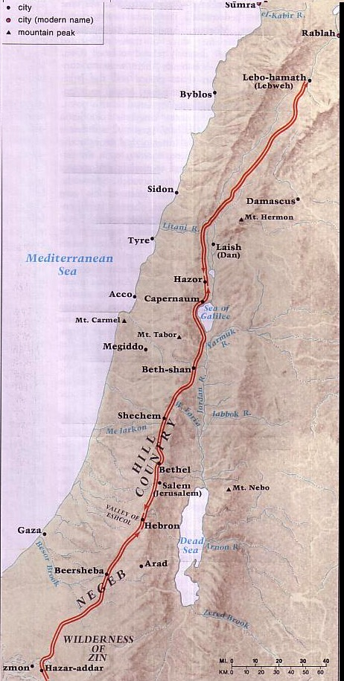
Journey of the Spies
Num. 13:21-24
142a
Barry Beitzel,
The Moody Atlas of Bible Lands, 93

Slide 73
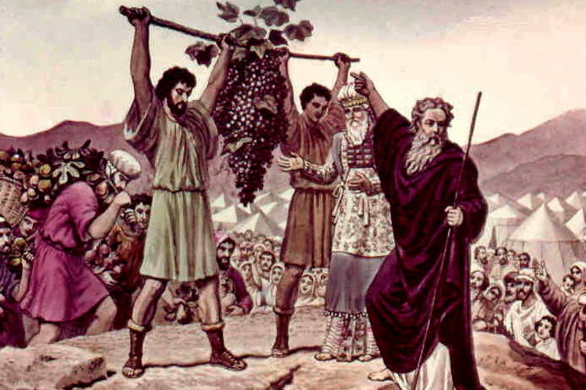
The Spies Return
Numbers 13

Slide 74
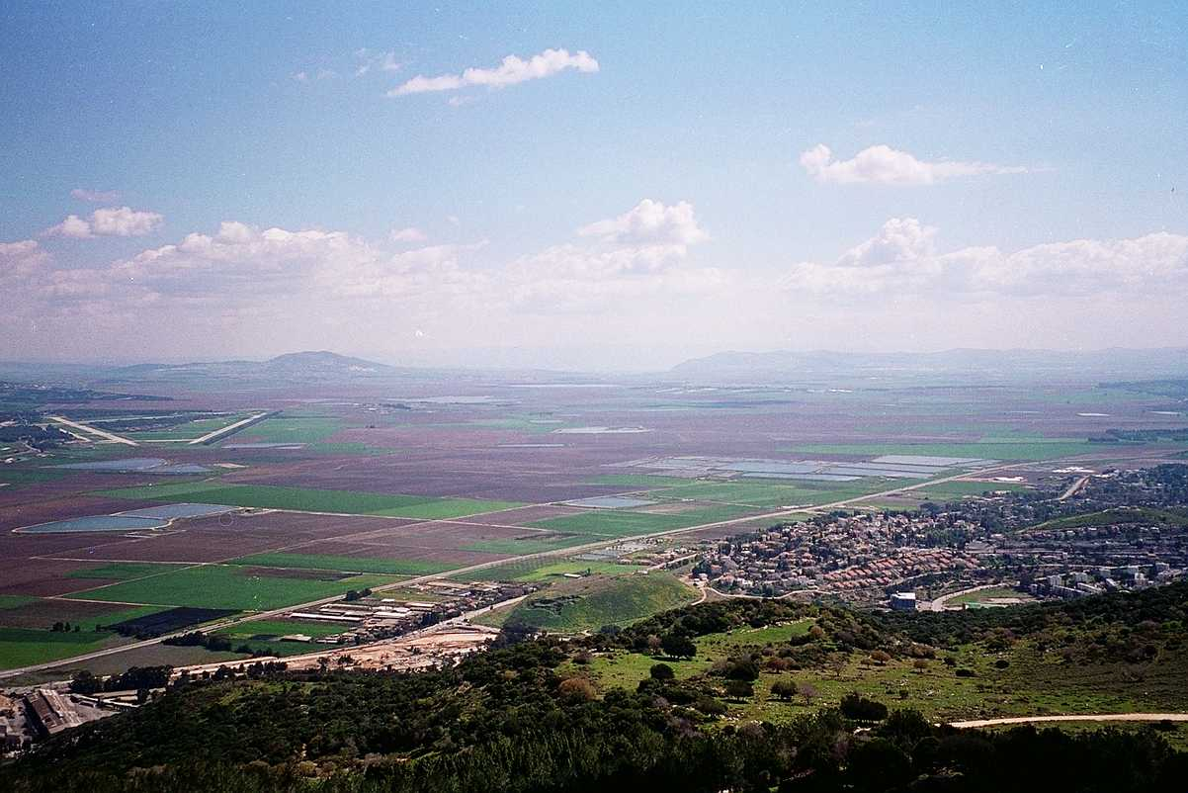
The Majority Report
G
ood
iants
rasshoppers
Numbers 13:26-33

Slide 75
The Minority Report
G
OD
Numbers 13:26-33

Slide 76
Slides on
Numbers 14

Slide 77
God's Report
Num. 13:26-14:9
DRESSING
THE
STAGE
Here's the situation:
MS
TWELVE SPIES: TWO REPORTS
10 SPIES: A MAJORITY OPINION
LAND OF MILK AND HONEY!
GIANTS IN THE LAND!
GO BACK TO EGYPT!
2 SPIES: A MINORITY OPINION
LAND OF MILK AND HONEY!
GIANTS IN THE LAND!
GOD IS WITH US!
N(A)
TRIP CANCELLED!
H
SG
C
ER
B
J
MN
MOSES
DS
Exodus
Sinai
E
M - C - C
Kadesh Barnea
KB
U
40
MS
PG
SO...LET'S GO!!!!!
RS
Handbook pg. 26-29
21

Slide 78

Key Verses
135
Discipline–"Not one of the men who saw my glory and the miraculous signs I performed in Egypt and in the desert but who disobeyed me these ten times—not one of them will ever see the land I promised on oath to their forefathers…" (God to Israel in Num. 14:22-23)

Slide 79
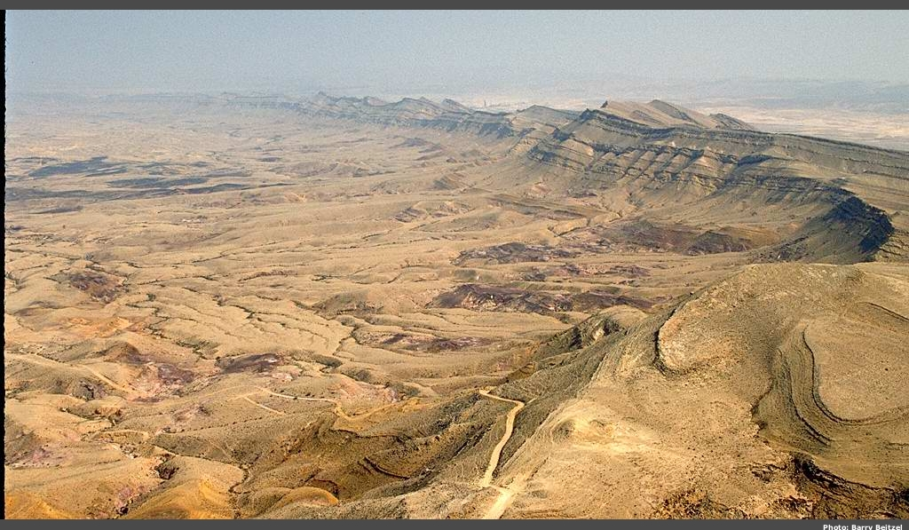
Wilderness of Zin

Slide 80
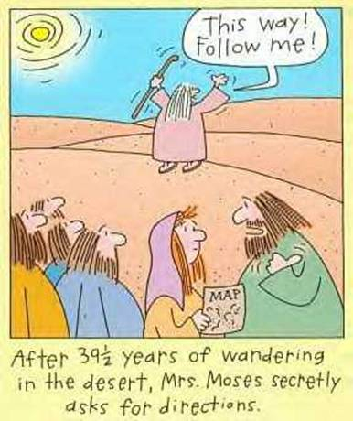
No Directions
This way!
Follow me!
After 39 1/2 years of wandering in the desert, Mrs. Moses secretly asks for directions.

Slide 81
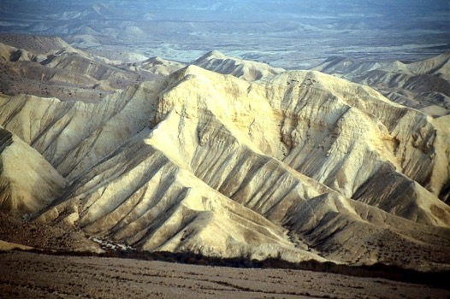
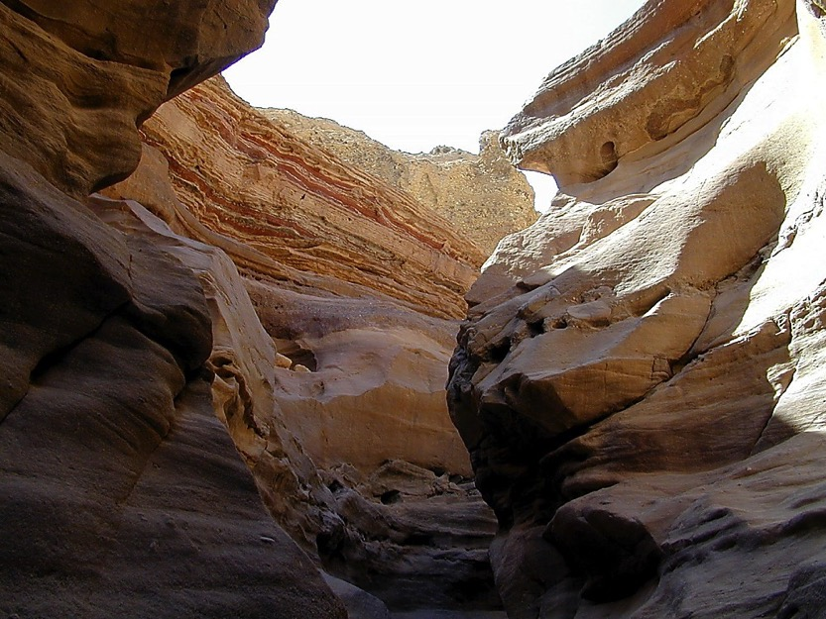
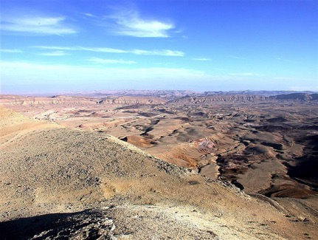
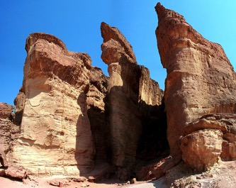
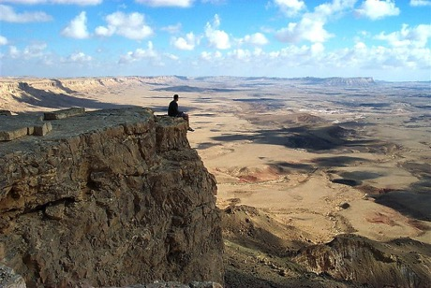
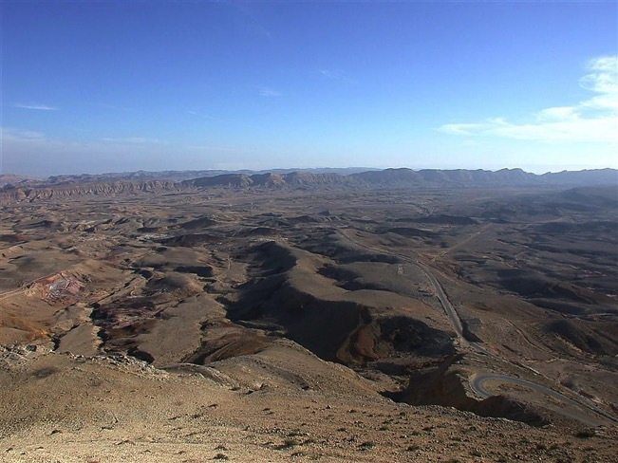
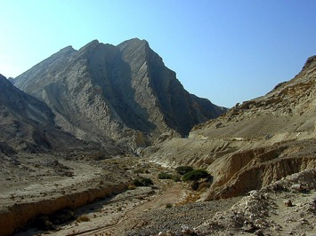
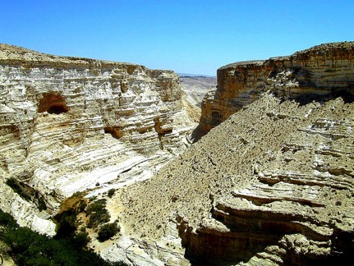
Divine Discipline
Num. 32:49; 34:1
DRESSING
THE
STAGE
YOU MEAN…
40 YEARS? OUT HERE?
MOSES
Exodus
Sinai
M - C - C
Kadesh Barnea
40
40
Handbook pg. 26-29
24

Slide 82
Slides on
Numbers 15

Slide 83

OT Discipline
Notes:
Death came to defiant believers in the OT, so discipline at least this severe would come to rejecting the Christ they knew (10:28-31).

Slide 84
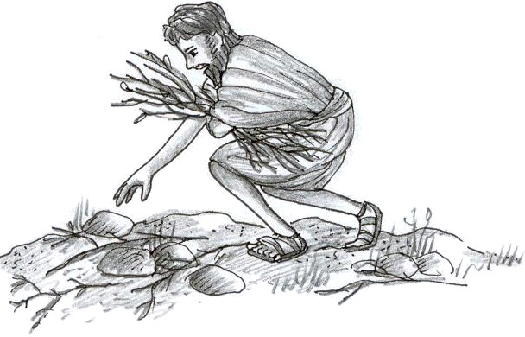
The Man Picking Up Sticks on the Sabbath (Numbers 15:30-36)
Notes:
Numbers 15:22-29 specifies sin offerings for Jewish believers who sinned unintentionally. But what should Israel do when God specifically told them not to work on the Sabbath on the penalty of death?
• Numbers 15:30-36 specifies death for capital crimes. Here was the case of intentional sin where a man caught in deliberate sin was stoned.

Slide 85
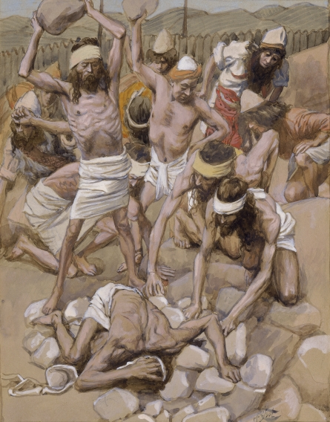
"For anyone who refused to obey the law of Moses was put to death without mercy on the testimony of two or three witnesses"
(Hebrews 10:28; cf. Num. 15:30-36 NLT).
Notes:
Numbers 15:22-29 specifies sin offerings for Jewish believers who sinned unintentionally. But what should Israel do when God specifically told them not to work on the Sabbath on the penalty of death?
• Numbers 15:30-36 specifies death for capital crimes. Here was the case of intentional sin where a man caught in deliberate sin was stoned.

Slide 86
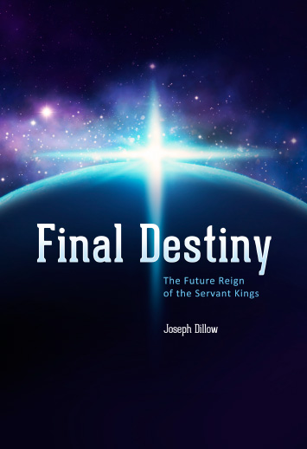

The Future Reign of the Servant Kings
Jody Dillow is the key author of the Partakers View
Final Destiny
The Future Reign of the Servant Kings
Joseph Dillow

Slide 87
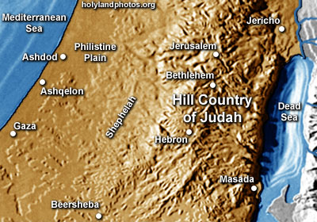
Inheritance in the OT

Slide 88
Inheritance in the OT
1. A difference exists between inheriting the land of Canaan and living there. The former refers to ownership and the latter to mere residence.
2. While Israel was promised the inheritance as a nation, the condition for maintaining their inheritance right to the land of Canaan was faith, obedience, and completion of one's task. The promise, while national, was applied only to the believing and obedient remnant.
Joseph Dillow, Final Destiny, 56

Slide 89
Inheritance in the OT
3. The inheritance is not to be equated with heaven but with something in addition to heaven, promised to those believers who faithfully obey the Lord.
4. Just as Old Testament believers forfeited their earthly inheritance through disobedience, we can also forfeit our future reward (inheritance) by a similar failure. Loss of inheritance, however, does not mean loss of salvation.
Joseph Dillow, Final Destiny, 56

Slide 90
Inheritance in the OT
5. Two kinds of inheritance were enjoyed in the Old Testament. All Israelites who had believed and were therefore regenerate had God as their inheritance but not all inherited the land. This paves the way for the concept that the New Testament may also teach two inheritances. We are all heirs of God, but we are not all joint-heirs with Christ, unless we persevere to the end of life. The former refers to our salvation and the latter to our reward.
Joseph Dillow, Final Destiny, 56

Slide 91
Inheritance in the OT
6. A child of Israel was both an heir of God and an heir of Canaan by virtue of faith in God resulting in regeneration. Yet only those believers in Israel who were faithful would maintain their status as firstborn sons who would actually receive what had been promised to them as an inheritance.
Joseph Dillow, Final Destiny, 56

Slide 92

Inheritance in the NT

Slide 93
Two Types of Inheritance
"Now if we are children, then we are heirs—heirs of God and co-heirs with Christ, if indeed we share in his sufferings in order that we may also share in his glory"
(Rom. 8:17 NIV).
= Salvation
= Reward

Slide 94
Numbers
135
Preparation to Occupy the Land
Preparing the
Old Generation
Postponement
for Unbelief
Preparing the
New Generation
1:1–10:10
10:11–25:18
26–36
God's Faithfulness
Israel's Faithlessness
God's Faithfulness
God's Blessings
God's Discipline
God's Blessings
Israel's Commitment
Israel's Complaining
Israel's Commitment
Order
Disorder
Reorder
Mount Sinai
Wilderness
Moab
20 Days
38 Years, 3 Months, 10 Days
ca. 5 Months
Organization
(1–4)
Sanctification (5:1–10:10)
To Kadesh (10:11–
12:16)
Kadesh Sin
(13–14)
Wilder-ness (15–19)
To Moab (20–21)
Moab
Sin
(22–25)
Provision for Land (26–27)
Offerings & Vows (28–30)
Final Preparations (31–36)

Slide 95
Slides on
Numbers 16

Slide 96
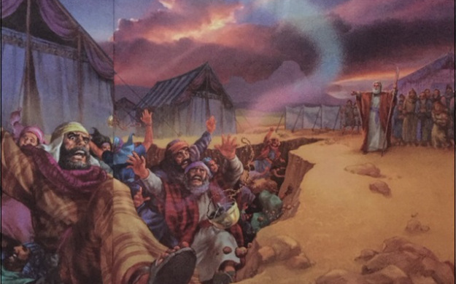
Korah's Rebellion
Korah, Dathan and Abiram (Numbers 16:31-34)

Slide 97
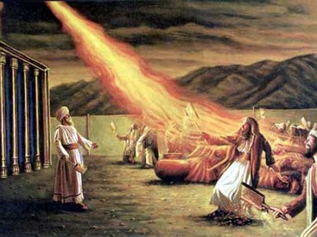
More Complaining
"Then fire blazed forth from the LORD and burned up the 250 men who were offering incense"
(Num 16:35 NLT).

Slide 98

Is Grumbling OK?
(After all, aren't most psalms
"Lament Psalms"?)

Slide 99
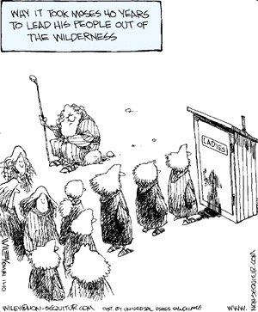
Grumbling in the Wilderness
Paul N. Benware, Survey of the Old Testament, 68
157a
SCRIPTURE
ISRAEL'S COMPLAINT
MOSES' RESPONSE
GOD'S RESPONSE
Why it took Moses 40 years to lead his people out of the wilderness
Exod. 14:11
Pharaoh's army
Encouraged Israel
to trust God
Delivered Israel
Exod. 15:24
Bitter water
Cried out to God
"Healed" the water
Exod. 16:2
Lack of food
Rebuked Israel
Supplied manna
Exod. 17:2
Lack of water
Prayed to the Lord
Water from the rock
Num. 11:1
God providing food
Anger & prayer
Judgment
Num. 14:2
Moses' leadership
Pled with Israel, prayed to God
Judgment
Num. 16:2
Moses' leadership
Rebuked & prayed
Judgment
Num. 16:41
Moses
Prayed
Judgment
Num. 20:2
Moses & lack of water
Rebuked Israel
Struck rock
Supplied water
Num. 21:4
Moses & manna
No response
Judgment

Slide 100
Slides on
Numbers 17

Slide 101

1 Corinthians 11:27-29 (NIV)
²⁷Therefore, whoever eats the bread or drinks the cup of the Lord in an unworthy manner will be guilty of sinning against the body and blood of the Lord. ²⁸A man ought to examine himself before he eats of the bread and drinks of the cup. ²⁹For anyone who eats and drinks without recognizing the body of the Lord eats and drinks judgment on himself.
Notes:
101

Slide 102
1 Corinthians 11:30-32 (NIV)
³⁰ That is why many among you are weak and sick, and a number of you have fallen asleep. ³¹But if we judged ourselves, we would not come under judgment. ³²When we are judged by the Lord, we are being disciplined so that we will not be condemned with the world.
Notes:
102

Slide 103
Slides on
Numbers 18

Slide 104
Slides on
Numbers 19

Slide 105

The Red Heifer
Pure Female for Purification (Numbers 19:1-5)
Notes:
Num. 19:1 The Lord said to Moses and Aaron, ² “Here is another legal requirement commanded by the Lord: Tell the people of Israel to bring you a red heifer, a perfect animal that has no defects and has never been yoked to a plow. ³ Give it to Eleazar the priest, and it will be taken outside the camp and slaughtered in his presence. ⁴ Eleazar will take some of its blood on his finger and sprinkle it seven times toward the front of the Tabernacle. ⁵ As Eleazar watches, the heifer must be burned—its hide, meat, blood, and dung. ⁶ Eleazar the priest must then take a stick of cedar, a hyssop branch, and some scarlet yarn and throw them into the fire where the heifer is burning.

Slide 106
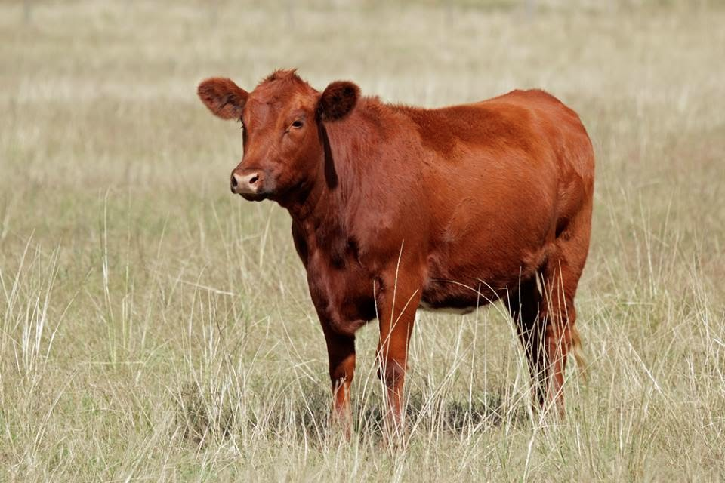
The Red Heifer
Holy cow!
Pure Female for Purification (Numbers 19:1-5)
Notes:
Num. 19:1 The Lord said to Moses and Aaron, ² “Here is another legal requirement commanded by the Lord: Tell the people of Israel to bring you a red heifer, a perfect animal that has no defects and has never been yoked to a plow. ³ Give it to Eleazar the priest, and it will be taken outside the camp and slaughtered in his presence. ⁴ Eleazar will take some of its blood on his finger and sprinkle it seven times toward the front of the Tabernacle. ⁵ As Eleazar watches, the heifer must be burned—its hide, meat, blood, and dung. ⁶ Eleazar the priest must then take a stick of cedar, a hyssop branch, and some scarlet yarn and throw them into the fire where the heifer is burning.

Slide 107
Slides on
Numbers 20

Slide 108
Numbers
135
Preparation to Occupy the Land
Preparing the
Old Generation
Postponement
for Unbelief
Preparing the
New Generation
1:1–10:10
10:11–25:18
26–36
God's Faithfulness
Israel's Faithlessness
God's Faithfulness
God's Blessings
God's Discipline
God's Blessings
Israel's Commitment
Israel's Complaining
Israel's Commitment
Order
Disorder
Reorder
Mount Sinai
Wilderness
Moab
20 Days
38 Years, 3 Months, 10 Days
ca. 5 Months
Organization
(1–4)
Sanctification (5:1–10:10)
To Kadesh (10:11–
12:16)
Kadesh Sin
(13–14)
Wilder-ness (15–19)
To Moab (20–21)
Moab
Sin
(22–25)
Provision for Land (26–27)
Offerings & Vows (28–30)
Final Preparations (31–36)

Slide 109

Water from a Rock (Num. 20:8)

Slide 110
Slides on
Numbers 21

Slide 111
Wandering Map
Kadesh- barnea
Mt. Hor
Mt. Sinai
Route of the Journey

Slide 112
More Complaining
Kadesh- barnea
Mt. Hor
"Then the people of Israel set out from Mount Hor, taking the road to the Red Sea to go around the land of Edom. But the people grew impatient with the long journey, ⁵and they began to speak against God and Moses. 'Why have you brought us out of Egypt to die here in the wilderness?' they complained. 'There is nothing to eat here and nothing to drink. And we hate this horrible manna!'" (Num 21:4-5 NLT).
Route of the Journey

Slide 113
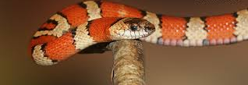
"So the LORD sent poisonous snakes among the people, and many were bitten and died. ⁷Then the people came to Moses and cried out, 'We have sinned by speaking against the LORD and against you. Pray that the LORD will take away the snakes.' So Moses prayed for the people" (Numbers 21:6-7 NLT).

Slide 114
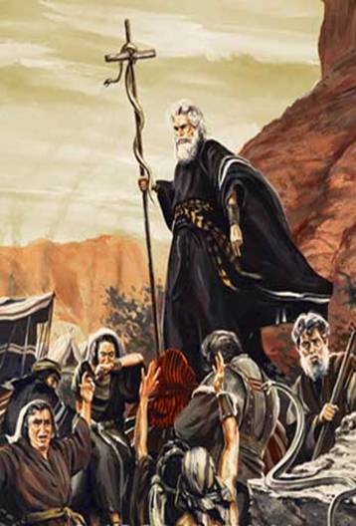
The Bronze Serpent
Numbers 21:8-9
Notes:
Num. 21:8-9 Then the Lord told him, “Make a replica of a poisonous snake and attach it to a pole. All who are bitten will live if they simply look at it!” ⁹ So Moses made a snake out of bronze and attached it to a pole. Then anyone who was bitten by a snake could look at the bronze snake and be healed!

Slide 115
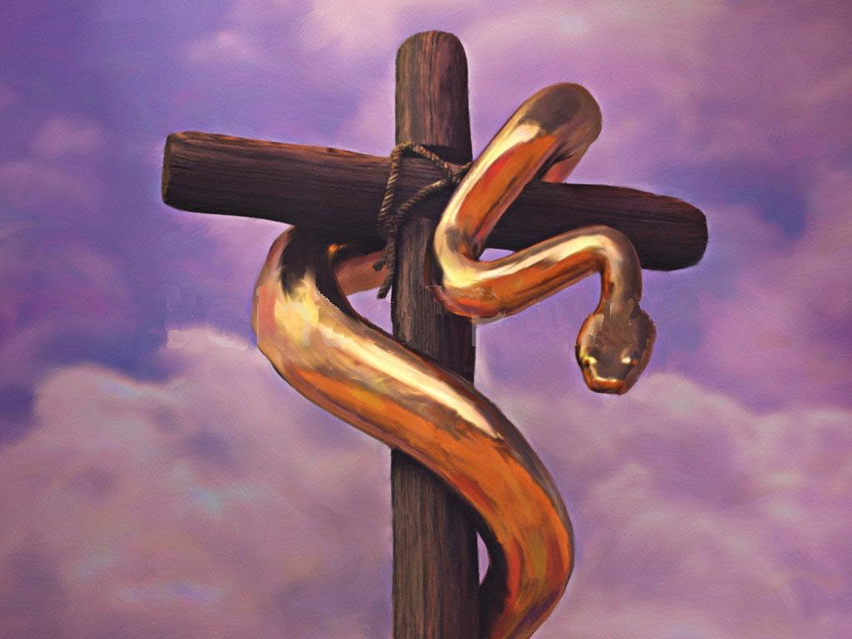

The Bronze Serpent
Numbers 21:8-9
Notes:
• The bronze serpent appears in dual form on the seal of the American Medical Association.

Slide 116
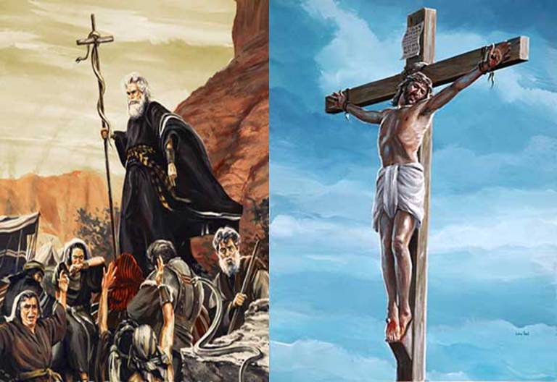
The Bronze Serpent
"And as Moses lifted up the bronze
snake on a pole in the wilderness,
so the Son of Man must be lifted up."
John 3:14 NLT
Notes:
John 3:14 And as Moses lifted up the bronze snake on a pole in the wilderness, so the Son of Man must be lifted up.

Slide 117
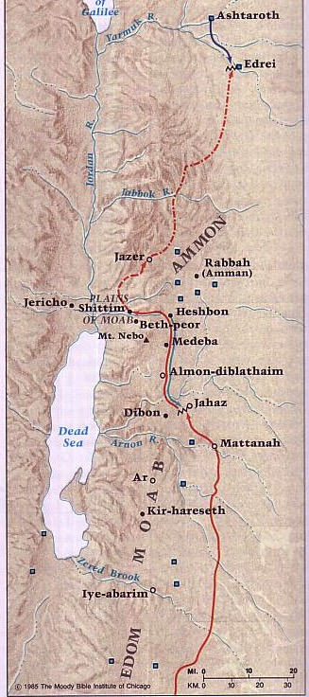
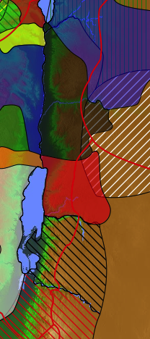
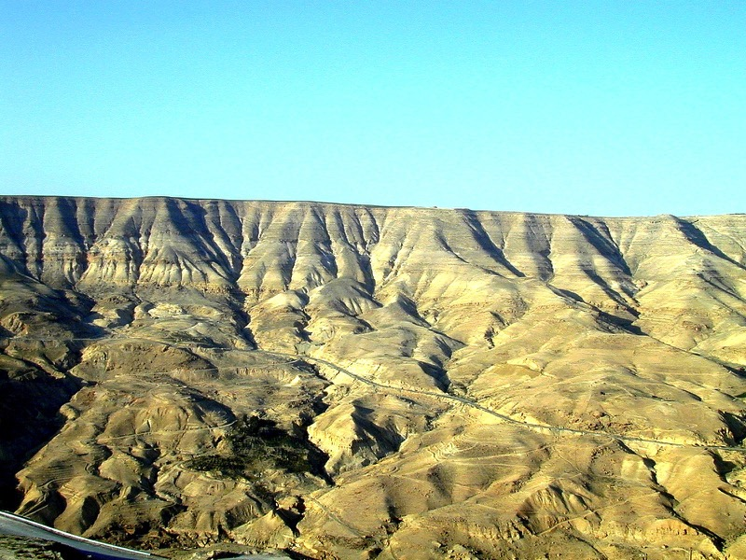
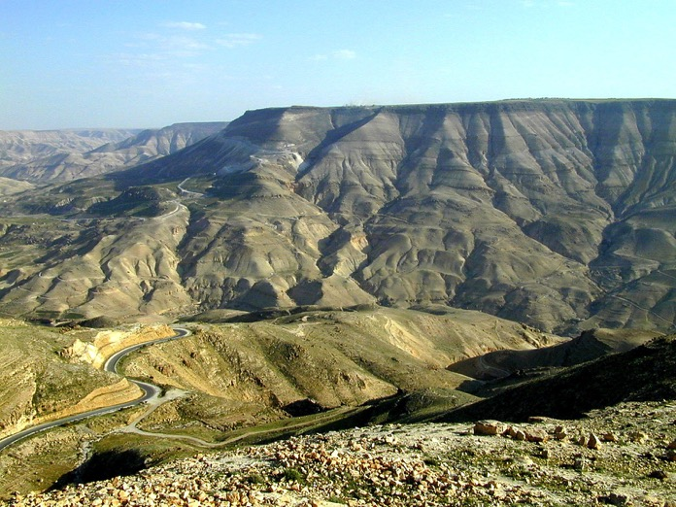
Transjordan Rivers
140
Looking North
Jabbok River
Ammon
The Arnon Gorge separated Moab from northern nations
Arnon River
Moab
Looking South
Edom
Beitzel, Moody Atlas, 1st ed., 94
Neighboring nations related by blood
Notes:
Num. 21:21 (NLT) The Israelites sent ambassadors to King Sihon of the Amorites with this message:
Num. 21:22 “Let us travel through your land. We will be careful not to go through your fields and vineyards. We won’t even drink water from your wells. We will stay on the king’s road until we have passed through your territory.”
Num. 21:23 But King Sihon refused to let them cross his territory. Instead, he mobilized his entire army and attacked Israel in the wilderness, engaging them in battle at Jahaz. ²⁴ But the Israelites slaughtered them with their swords and occupied their land from the Arnon River to the Jabbok River. They went only as far as the Ammonite border because the boundary of the Ammonites was fortified.
Num. 21:25 So Israel captured all the towns of the Amorites and settled in them, including the city of Heshbon and its surrounding villages. ²⁶ Heshbon had been the capital of King Sihon of the Amorites. He had defeated a former Moabite king and seized all his land as far as the Arnon River. ²⁷ Therefore, the ancient poets wrote this about him:
“Come to Heshbon and let it be rebuilt!
Let the city of Sihon be restored.
²⁸ A fire flamed forth from Heshbon,
a blaze from the city of Sihon.
It burned the city of Ar in Moab;
it destroyed the rulers of the Arnon heights.
²⁹ What sorrow awaits you, O people of Moab!
You are finished, O worshipers of Chemosh!
Chemosh has left his sons as refugees,
his daughters as captives of Sihon, the Amorite king.
³⁰ We have utterly destroyed them,
from Heshbon to Dibon.
We have completely wiped them out
as far away as Nophah and Medeba.”
Num. 21:31 So the people of Israel occupied the territory of the Amorites. ³² After Moses sent men to explore the Jazer area, they captured all the towns in the region and drove out the Amorites who lived there. ³³ Then they turned and marched up the road to Bashan, but King Og of Bashan and all his people attacked them at Edrei. ³⁴ The Lord said to Moses, “Do not be afraid of him, for I have handed him over to you, along with all his people and his land. Do the same to him as you did to King Sihon of the Amorites, who ruled in Heshbon.” ³⁵ And Israel killed King Og, his sons, and all his subjects; not a single survivor remained. Then Israel occupied their land.

Slide 118
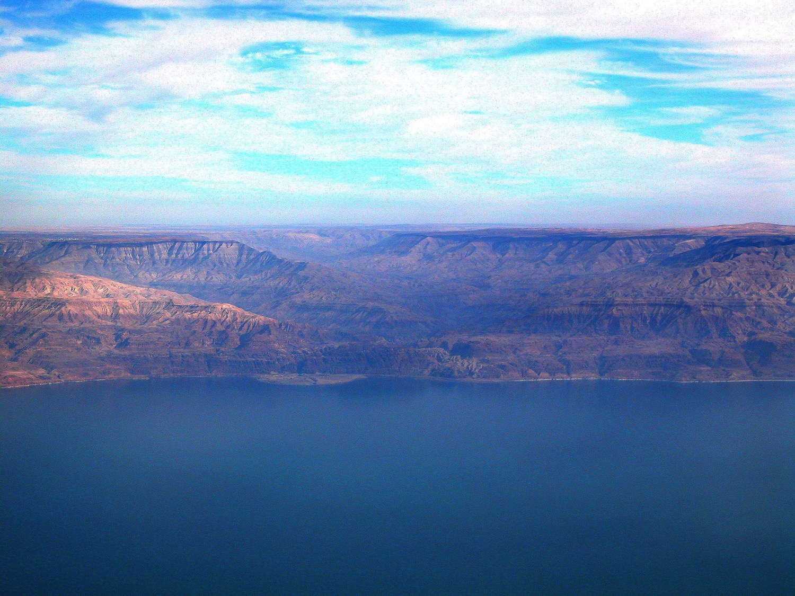
Nahal Arnon (Arnon River)
An arial view from the west above the Dead Sea

Slide 119
Transjordan Events
140
Edrei
Kingdom of Og
Jabbok River
Ammon
Victory over Sihon and Og (Num. 21:21-35)
Kingdom of Sihon
Jahaz
Arnon River
Moab
Edom
Beitzel, Moody Atlas, 1st ed., 94
Neighboring nations related by blood
Notes:
Num. 21:21 (NLT) The Israelites sent ambassadors to King Sihon of the Amorites with this message:
Num. 21:22 “Let us travel through your land. We will be careful not to go through your fields and vineyards. We won’t even drink water from your wells. We will stay on the king’s road until we have passed through your territory.”
Num. 21:23 But King Sihon refused to let them cross his territory. Instead, he mobilized his entire army and attacked Israel in the wilderness, engaging them in battle at Jahaz. ²⁴ But the Israelites slaughtered them with their swords and occupied their land from the Arnon River to the Jabbok River. They went only as far as the Ammonite border because the boundary of the Ammonites was fortified.
Num. 21:25 So Israel captured all the towns of the Amorites and settled in them, including the city of Heshbon and its surrounding villages. ²⁶ Heshbon had been the capital of King Sihon of the Amorites. He had defeated a former Moabite king and seized all his land as far as the Arnon River. ²⁷ Therefore, the ancient poets wrote this about him:
“Come to Heshbon and let it be rebuilt!
Let the city of Sihon be restored.
²⁸ A fire flamed forth from Heshbon,
a blaze from the city of Sihon.
It burned the city of Ar in Moab;
it destroyed the rulers of the Arnon heights.
²⁹ What sorrow awaits you, O people of Moab!
You are finished, O worshipers of Chemosh!
Chemosh has left his sons as refugees,
his daughters as captives of Sihon, the Amorite king.
³⁰ We have utterly destroyed them,
from Heshbon to Dibon.
We have completely wiped them out
as far away as Nophah and Medeba.”
Num. 21:31 So the people of Israel occupied the territory of the Amorites. ³² After Moses sent men to explore the Jazer area, they captured all the towns in the region and drove out the Amorites who lived there. ³³ Then they turned and marched up the road to Bashan, but King Og of Bashan and all his people attacked them at Edrei. ³⁴ The Lord said to Moses, “Do not be afraid of him, for I have handed him over to you, along with all his people and his land. Do the same to him as you did to King Sihon of the Amorites, who ruled in Heshbon.” ³⁵ And Israel killed King Og, his sons, and all his subjects; not a single survivor remained. Then Israel occupied their land.

Slide 120
Slides on
Numbers 22

Slide 121
Numbers
135
Preparation to Occupy the Land
Preparing the
Old Generation
Postponement
for Unbelief
Preparing the
New Generation
1:1–10:10
10:11–25:18
26–36
God's Faithfulness
Israel's Faithlessness
God's Faithfulness
God's Blessings
God's Discipline
God's Blessings
Israel's Commitment
Israel's Complaining
Israel's Commitment
Order
Disorder
Reorder
Mount Sinai
Wilderness
Moab
20 Days
38 Years, 3 Months, 10 Days
ca. 5 Months
Organization
(1–4)
Sanctification (5:1–10:10)
To Kadesh (10:11–
12:16)
Kadesh Sin
(13–14)
Wilder-ness (15–19)
To Moab (20–21)
Moab
Sin
(22–25)
Provision for Land (26–27)
Offerings & Vows (28–30)
Final Preparations (31–36)

Slide 122
Transjordan Events
140
Ammon
Moab
Balak (king of Moab) feels threatened by the huge nation of Israel at his border
Edom
Beitzel, Moody Atlas, 1st ed., 94
Neighboring nations related by blood

Slide 123

The Balaam Narrative (Num. 22–24)
140
Balak
King of Moab
Balaam
Pagan Prophet
Beitzel, Moody Atlas, 1st ed., 94
Notes:
Num. 22:1 Then the people of Israel traveled to the plains of Moab and camped east of the Jordan River, across from Jericho. ² Balak son of Zippor, the Moabite king, had seen everything the Israelites did to the Amorites. ³ And when the people of Moab saw how many Israelites there were, they were terrified. ⁴ The king of Moab said to the elders of Midian, “This mob will devour everything in sight, like an ox devours grass in the field!” So Balak, king of Moab, ⁵ sent messengers to call Balaam son of Beor, who was living in his native land of Pethor near the Euphrates River. His message said:

Slide 124
Transjordan Events
Balak hires the pagan prophet Balaam to curse Israel
140
Ammon
Balaam blesses Israel instead (Num. 22–24)!
Moab
Balak (king of Moab) feels threatened by the huge nation of Israel at his border
Edom
Beitzel, Moody Atlas, 1st ed., 94
Neighboring nations related by blood
Notes:
Num. 22:6 “Look, a vast horde of people has arrived from Egypt. They cover the face of the earth and are threatening me. Please come and curse these people for me because they are too powerful for me. Then perhaps I will be able to conquer them and drive them from the land. I know that blessings fall on any people you bless, and curses fall on people you curse.”

Slide 125
Transjordan Events
140
Edrei
Kingdom of Og
Ammon
Victory over Sihon and Og (Num. 21:21-35)
Balak fails to turn God against Israel—blessing by Balaam (Num. 22–24)
Kingdom of Sihon
Jahaz
Moab
Edom
Beitzel, Moody Atlas, 1st ed., 94
Neighboring nations related by blood

Slide 126


Balaam
Balaam Numbers 22:20-35
Notes:
Num. 22:20 That night God came to Balaam and told him, “Since these men have come for you, get up and go with them. But do only what I tell you to do.”
Num. 22:21 So the next morning Balaam got up, saddled his donkey, and started off with the Moabite officials. ²² But God was angry that Balaam was going, so he sent the angel of the Lord to stand in the road to block his way. As Balaam and two servants were riding along, ²³ Balaam’s donkey saw the angel of the Lord standing in the road with a drawn sword in his hand. The donkey bolted off the road into a field, but Balaam beat it and turned it back onto the road. ²⁴ Then the angel of the Lord stood at a place where the road narrowed between two vineyard walls. ²⁵ When the donkey saw the angel of the Lord, it tried to squeeze by and crushed Balaam’s foot against the wall. So Balaam beat the donkey again. ²⁶ Then the angel of the Lord moved farther down the road and stood in a place too narrow for the donkey to get by at all. ²⁷ This time when the donkey saw the angel, it lay down under Balaam. In a fit of rage Balaam beat the animal again with his staff.
Num. 22:28 Then the Lord gave the donkey the ability to speak. “What have I done to you that deserves your beating me three times?” it asked Balaam.
Num. 22:29 “You have made me look like a fool!” Balaam shouted. “If I had a sword with me, I would kill you!”
Num. 22:30 “But I am the same donkey you have ridden all your life,” the donkey answered. “Have I ever done anything like this before?” “No,” Balaam admitted.
Num. 22:31 Then the Lord opened Balaam’s eyes, and he saw the angel of the Lord standing in the roadway with a drawn sword in his hand. Balaam bowed his head and fell face down on the ground before him.
Num. 22:32 “Why did you beat your donkey those three times?” the angel of the Lord demanded. “Look, I have come to block your way because you are stubbornly resisting me. ³³ Three times the donkey saw me and shied away; otherwise, I would certainly have killed you by now and spared the donkey.”
Num. 22:34 Then Balaam confessed to the angel of the Lord, “I have sinned. I didn’t realize you were standing in the road to block my way. I will return home if you are against my going.”
Num. 22:35 But the angel of the Lord told Balaam, “Go with these men, but say only what I tell you to say.” So Balaam went on with Balak’s officials.

Slide 127
Slides on
Numbers 23

Slide 128

The Balaam Narrative
140
Balak fails to turn God against Israel–blessing by Balaam (Num. 22–24)
Beitzel, Moody Atlas, 1st ed., 94

Slide 129
Key Verses
135
Discipline–"Not one of the men who saw my glory and the miraculous signs I performed in Egypt and in the desert but who disobeyed me these ten times—not one of them will ever see the land I promised on oath to their forefathers…" (God to Israel in Num. 14:22-23)
Blessing–"God is not a man, that he should lie, nor a son of man, that he should change his mind. Does he speak and then not act? Does he promise and not fulfill? I have received a command to bless; he has blessed, and I cannot change it" (Balaam to Balak in Num. 23:19-20)

Slide 130
Slides on
Numbers 24

Slide 131
2 Peter 2:15-16 (NIV)
"They have left the straight way and wandered off to follow the way of Balaam son of Beor, who loved the wages of wickedness. But he was rebuked for his wrongdoing by a donkey—a beast without speech—who spoke with a man's voice and restrained the prophet's madness."

Slide 132
Slides on
Numbers 25

Slide 133
Transjordan Events
140
Victory over Sihon and Og (Num. 21:21-35)
Balak fails to turn God against Israel—blessing by Balaam (Num. 22–24)
Balak succeeds to turn Israel against God–immorality at Beth-peor (Num. 25)
Beth-peor
Beitzel, Moody Atlas, 1st ed., 94

Slide 134
Jude 11 (NIV)
"Woe to them! They have taken the way of Cain; they have rushed for profit into Balaam's error; they have been destroyed in Korah's rebellion."

Slide 135


The Balaam Narrative (Num. 22–24)
140
Balak turned Israel against God via immorality at Beth-peor (Num. 25)
Beitzel, Moody Atlas, 1st ed., 94

Slide 136
Revelation 2:14-15
"Nevertheless, I have a few things against you: You have people there who hold to the teaching of Balaam, who taught Balak to entice the Israelites to sin by eating food sacrificed to idols and by committing sexual immorality. Likewise you also have those who hold to the teaching of the Nicolaitans."

Slide 137

God instructs us through the failures of others.

Slide 138

Sometimes marriages fail so...

Slide 139

... grandparents are parents again

Slide 140
Salvation & Sanctification
121a
Man's Role
God's Response
Life of Faith
Restored Fellowship
Faith in God as offered Passover Lamb
Journey to Canaan
Sacrifices
(Sin, Guilt)
OT
Exodus
Type
|
Antitype
Type
|
Antitype
Type
|
Antitype
Type
|
Antitype
Faith in Christ as Lamb of God (1 Cor. 5:7)
Salvation
(1 Cor. 10:1-4)
Growth
(1 Cor. 10:5)
Confession
(1 John 1:9)
NT
Positional Sanctification
Progressive Sanctification

Slide 141

However, there is still divine discipline…

Slide 142


Ananias & Sapphira
Acts 5

Slide 143

Rewards can be lost!
"Watch out that you do not lose what we have worked so hard to achieve. Be diligent so that you receive your full reward" (2 John 8 NLT)
"I have given you an open door that no one can shut" (3:8)

Slide 144

Some sin leads to premature death (1 John 5:16-17 NIV)
"If anyone sees his brother commit a sin that does not lead to death, he should pray and God will give him life. I refer to those whose sin does not lead to death. There is a sin that leads to death. I am not saying that he should pray about that. ¹⁷All wrongdoing is sin, and there is sin that does not lead to death."

Slide 145
Slides on
Numbers 26

Slide 146
How does God prepare us to serve him?

Slide 147
I. God organizes us to be holy.
Numbers 1:1–10:10
Notes:
The LORD sets us apart by arranging us.

Slide 148
II. God warns us of the cost of unbelief.
Plan
For Disaster
Now
Numbers 10:11–25:18
Notes:
The LORD disciplines us with loss of reward.

Slide 149

III. God rewards our faithfulness.
Numbers 26–36
Notes:
The LORD will return to us far more than we ever gave him in our service.

Slide 150
Argument
136
While Leviticus relates to the nation's worship, Numbers records the nation's walk.
God prepared Israel to walk with Him in a covenant relationship (1:1–10:10).
God is faithful to His covenants, so He prepared a new generation to enter the land
(chs. 26–36).
Yet the nation postponed entrance into the land by unbelief (10:11–25:18).
The narrative continually contrasts God's faithfulness with Israel's faithlessness.

Slide 151
Theme
135
Preparation
to Occupy the Land
Numbers

Slide 152
Numbers
135
Preparation to Occupy the Land
Preparing the
Old Generation
Postponement
for Unbelief
Preparing the
New Generation
1:1–10:10
10:11–25:18
26–36
God's Faithfulness
Israel's Faithlessness
God's Faithfulness
God's Blessings
God's Discipline
God's Blessings
Israel's Commitment
Israel's Complaining
Israel's Commitment
Order
Disorder
Reorder
Mount Sinai
Wilderness
Moab
20 Days
38 Years, 3 Months, 10 Days
ca. 5 Months
Organization
(1–4)
Sanctification (5:1–10:10)
To Kadesh (10:11–
12:16)
Kadesh Sin
(13–14)
Wilder-ness (15–19)
To Moab (20–21)
Moab
Sin
(22–25)
Provision for Land (26–27)
Offerings & Vows (28–30)
Final Preparations (31–36)

Slide 153
Population Changes in the Wilderness
140
Tribe | Num. 1 (1444 BC) Start of Wanderings | Num. 26 (1406 BC) End of Wanderings | Increase (Decrease)
Reuben | 46,500 | 43,730 | (2,770)
Simeon | 59,300 | 22,200 | (37,100)
Gad | 45,650 | 40,500 | (5,150)
Judah | 74,600 | 76,500 | 1,900
Isaachar | 54,400 | 64,300 | 9,900
Zebulun | 57,400 | 60,500 | 3,100
Ephraim | 40,500 | 32,500 | (8,000)
Manasseh | 32,200 | 52,700 | 20,500
Benjamin | 35,400 | 45,600 | 10,200
Dan | 62,700 | 64,400 | 1,700
Asher | 41,500 | 53,400 | 11,900
Naphtali | 53,400 | 45,400 | (8,000)
Total | 603,550 | 601,730 | (1,820)
Levi | 22,000 | 23,000 | 1,000

Slide 154

Populations by Tribe
171
Asher
53,400
Naphtali
45,400
Numbers 26
Joshua 13:1–19:48
Zebulun
60,500
Manasseh
Issachar
64,300
Manasseh
52,700
Levi
23,000
Spread Throughout Israel
Gad
40,500
Ephraim
32,500
Dan
64,400
Benjamin
45,600
Reuben
43,730
Judah
76,500
Simeon
22,200

Slide 155
Slides on
Numbers 27

Slide 156
Numbers
135
Preparation to Occupy the Land
Preparing the
Old Generation
Postponement
for Unbelief
Preparing the
New Generation
1:1–10:10
10:11–25:18
26–36
God's Faithfulness
Israel's Faithlessness
God's Faithfulness
God's Blessings
God's Discipline
God's Blessings
Israel's Commitment
Israel's Complaining
Israel's Commitment
Order
Disorder
Reorder
Mount Sinai
Wilderness
Moab
20 Days
38 Years, 3 Months, 10 Days
ca. 5 Months
Organization
(1–4)
Sanctification (5:1–10:10)
To Kadesh (10:11–
12:16)
Kadesh Sin
(13–14)
Wilder-ness (15–19)
To Moab (20–21)
Moab
Sin
(22–25)
Provision for Land (26–27)
Offerings & Vows (28–30)
Final Preparations (31–36)

Slide 157
Slides on
Numbers 28

Slide 158

Special Offerings (Num. 28:1-15)
Introduction (1-2)
Daily (3-8)
Sabbath (9-10)
Monthly (11-15)

Slide 159
Slides on
Numbers 29

Slide 160


Feasts of Numbers 28–29 (in red)
180
1 Nisan
2 Iyar
3 Sivan
4 Tammuz
5 Av
6 Ellul
7 Tishri
8 Cheshvan
9 Kislev
10 Tevet
11 Shevat
12 Adar
(Passover)
Redemption
(Unleavened Bread)
Separation
(Firstfruits)
Resurrection
(Pentecost)
Spirit
Kingdom
(Tabernacles/Booths)
Repentance
(Day of Atonement)
Rapture
(Trumpets)
3 Pilgrimage Feasts

Slide 161
Slides on
Numbers 30

Slide 162
Numbers
135
Preparation to Occupy the Land
Preparing the
Old Generation
Postponement
for Unbelief
Preparing the
New Generation
1:1–10:10
10:11–25:18
26–36
God's Faithfulness
Israel's Faithlessness
God's Faithfulness
God's Blessings
God's Discipline
God's Blessings
Israel's Commitment
Israel's Complaining
Israel's Commitment
Order
Disorder
Reorder
Mount Sinai
Wilderness
Moab
20 Days
38 Years, 3 Months, 10 Days
ca. 5 Months
Organization
(1–4)
Sanctification (5:1–10:10)
To Kadesh (10:11–
12:16)
Kadesh Sin
(13–14)
Wilder-ness (15–19)
To Moab (20–21)
Moab
Sin
(22–25)
Provision for Land (26–27)
Offerings & Vows (28–30)
Final Preparations (31–36)

Slide 163
Slides on
Numbers 31

Slide 164

Final Preparations (31–36)
Tribal Boundaries of Israel
Naphtali
Asher
Transjordan Settled (31–32)
  Midianites (31)
Zebulun
Manasseh
Issachar
Manasseh
Gad
Ephraim
Dan
Benjamin
Reuben
Judah
Simeon

Slide 165
Slides on
Numbers 32

Slide 166
Final Preparations (31–36)
Eastern Tribes
Transjordan Settled (31–32)
  Midianites (31)
  Inheritances (32)
Manasseh
Gad
Reuben

Slide 167
Slides on
Numbers 33

Slide 168
Final Preparations (31–36)
Eastern Tribes
Transjordan Settled (31–32)
  Midianites (31)
  Inheritances (32)
Wandering Summary (33:1-49)
Canaan Defined (33:50–36:13)
  Inheritance (33:50–34:29)
Manasseh
Gad
Reuben

Slide 169
Slides on
Numbers 34

Slide 170

Borders of the Land Promised to Abraham
Syria
Lebanon
Israel
Jordan
Genesis 15:18
"On that day the LORD made a covenant with Abram, saying, 'To your offspring I give this land, from the river of Egypt to the great river, the river Euphrates'" (ESV)
India
Egypt
Notes:
God’s promised land stretched northeard from the small wadi of Egypt south in the Sinai to the large Euphrates River in the far north—a HUGE piece of real estate! When today’s boundaries are placed over this land we can see the struggle modern Israel has to claim land from Egypt, Lebanon, Syria and possibly even Jordan on the other side of the Jordan River.

Slide 171

Promised Land Borders to Moses (Num 34)
Syria
Lebanon
Jordan
Israel
Egypt
Notes:
God’s promised land stretched northeard from the small wadi of Egypt south in the Sinai to the large Euphrates River in the far north—a HUGE piece of real estate! When today’s boundaries are placed over this land we can see the struggle modern Israel has to claim land from Egypt, Lebanon, Syria and possibly even Jordan on the other side of the Jordan River.

Slide 172
Final Preparations (31–36)
Eastern Tribes
Transjordan Settled (31–32)
  Midianites (31)
  Inheritances (32)
Wandering Summary (33:1-49)
Canaan Defined (33:50–36:13)
  Inheritance (33:50–34:29)
Manasseh
Gad
Reuben
Moab
Edom

Slide 173
Slides on
Numbers 35

Slide 174
Final Preparations (31–36)
Eastern Tribes
Transjordan Settled (31–32)
  Midianites (31)
  Inheritances (32)
Wandering Summary (33:1-49)
Canaan Defined (33:50–36:13)
  Inheritance (33:50–34:29)
  Levitical Cities (35)
Manasseh
Gad
Reuben

Slide 175

48 Levitical Cities
171a
6 Cities of Refuge
Numbers 35

Slide 176


Cities of Refuge
Israel lived in a nomadic culture of personal vengeance by family members against the offending family (blood feuds).
Yet the nation was not ready for legal procedures by an objective village assembly (civil law).
Therefore, God instituted an intermediate step of six nearby cities where one who accidently killed someone could flee.
142
Kedesh
Golan
Ramoth
Shechem
Bezer
Hebron
Numbers 35; Josh. 20:1-9
Notes:
"The idea of providing cities of refuge (Josh. 20:1-9) for capital offenses is rooted in the tension between customary tribal law (retaliation or revenge, in which the blood relative is obligated to execute vengeance) and civil law (carried out less personally by an assembly according to a standard code of justice)" (The Bible Visual Resource Book, 35).

Slide 177
Final Preparations (31-36)
Tribal Boundaries of Israel
Naphtali
Asher
Transjordan Settled (31-32)
  Midianites (31)
  Inheritances (32)
Wandering Summary (33:1-49)
Canaan Defined (33:50–36:13)
  Inheritance (33:50–34:29)
  Levitical Cities (35)
  Daughters (36)
Zebulun
Manasseh
Issachar
Manasseh
Gad
Ephraim
Dan
Benjamin
Reuben
Judah
Simeon

Slide 178
Slides on
Numbers 36

Slide 179


Daughters of Zelophehad (Num. 36)
Mahlah
Noah
Hoglah
Milcah
Tirzah

Slide 180
Geographical End of Numbers
Moab
Kadesh- barnea
Mt. Hor
Mt. Sinai

Slide 181

God will continue leading you when you are obedient.
Notes:
Death came to defiant believers in the OT, so discipline at least this severe would come to rejecting the Christ they knew (10:28-31).

Slide 182

Do you really doubt that God will forget to reward you?

Slide 183


Crowns in the NT
Incorruptible
1 Cor. 9:25
Hope
1 Thess. 2:19
Righteousness
2 Tim. 4:8
Life
Jas 1:12;
Rev 2:10
Glory
1 Pet. 5:4
Notes:
Rick Griffith, Eschatology notes, 189
2. What is the nature of the heavenly rewards? What will these rewards be like?
a. Rewards of Possession
1) Five crowns (stephanos) are noted as personal possessions in heaven (cf. p. 76). These crowns are not kingly crowns (diadems) but victor's wreaths made of vines or leaves (or even gold and silver in the form of a garland or wreath):
An incorruptible crown is for those who master their flesh (1 Cor. 9:25).
A crown of hope or joy is for those who bore fruit in others' lives for Christ (1 Thess. 2:19). This is sometimes called the soul-winner's crown.
A crown of life is for believers who patiently endure trials and suffering (James 1:12; Rev. 2:10).
A crown of glory rewards spiritual shepherds who feed the flock (1 Pet. 5:4).
A crown of righteousness is for one longing for Christ's return (2 Tim. 4:8).
b. Rewards of Responsibility (cf. W. A. Criswell and Paige Patterson, Heaven, 208-14)
1) In Luke 19:11-27 (Parable of the Ten Minas) Jesus taught that before going on a journey, a nobleman gave each of his ten servants the same amount of money—one mina each. Upon returning, the master rewarded each accordingly with differing degrees of responsibility based on their faithfulness.
2) Matthew 25:14-30 (Parable of the Talents) records a similar story, except each man received a different amount of money to invest for his master (the one who buried his master's money depicts an unsaved man, v. 30). This parable also depicts varying degrees of reward: "His master replied, 'Well done, good and faithful servant! You have been faithful with a few things; I will put you in charge of many things. Come and share your master's happiness'" (v. 21).
2) We too often view ownership as sinful, though this is not scriptural.
a) As joint-heirs with Christ (Rom. 8:17; Heb. 1:2), we own what He owns! This is joint-ownership in a communal sense but "to deny private property inevitably ends in denying privacy" (Gilmore, 302) much like the mystical idea of blending into the "Total One." Ownership in heaven will not include the sinful possessiveness of earth.
b) We have a heavenly inheritance which is "imperishable and undefiled, and will not fade away, reserved in heaven for you" (1 Pet. 1:4 NASB).
3. However, a recent article argues against levels of reward (Craig L. Blomberg, "Degrees of Reward in the Kingdom of Heaven?" Journal of the Evangelical Theological Society 35 [June 1992]: 159-72). He provides some interesting thoughts:
a. The vineyard worker parable teaches that each worker received the same pay no matter how long he worked (Matt. 20:1-16). This teaches that all believers are rewarded equally since all receive pay by grace. The ending, "the last shall be first, and the first, last" (v. 16), means that all positions in heaven are interchangeable.
Response: Do they indeed receive pay by grace? In each case the pay was for work, not faith. The main point that "the last shall be first, and the first, last" (v. 16) may better indicate that God's system of ranking people in heaven differs from that which man uses on earth.
b. Scholars do not agree on the form these differing heavenly rewards will take. Suggestions include capacity for service, added responsibilities, degree of bliss, possessions, and an enriched relationship with God.
Response: Our ignorance of the type of reward does not deny its existence (see preceding discussion for more details on types of reward).
c. If heaven is perfection, how can there be varying degrees of perfection?
Response: This may seem inappropriate from our vantage point since we are not God, but he has made many perfect things which differ in quality even in our present world. For example, plants are perfectly made yet less durable than jewels.
d. Blomberg considers passages generally used to teach rewards not convincing.
1) The crown passages speak of the reward of eternal life itself, not something in addition to it (1 Cor. 9:25; 1 Thess. 2:19; 2 Tim. 4:8; Jas. 1:12; 1 Pet. 5:4). [But this does not seem to be the normal reading of each passage.]
2) The texts about those who are the "least" or "greatest" relate only to the "present aspects of the kingdom" (Matt. 5:19; 11:11; 18:4; Mark 9:34-35; Luke 9:48). [No, for people here are compared with the least of the people there.]
3) The quality of each man's works and their rewards (1 Cor. 3:11-15) relates to degree of shame or satisfaction at the judgment (cf. 1 John 2:28), not the lasting results of it which persist for all time in an everlasting hierarchy. [Even this is not correct, since verse 14 declares that "if what he has built survives, he will receive his reward." It is true that the nature of the reward is not stated, so the belief that it is merely momentary satisfaction may be true or false—no one knows. However, 2 Corinthians 5:10 does indicate that each will be judged for his deeds and "will receive what is due him."]
Other arguments of Blomberg should be considered. This article is worth reading. Perhaps we need to re-evaluate long-held views in this area.

Slide 184

Christ promises rewards for perseverance (Rev. 3:11b).
"I am coming soon. Hold on to what you have, so that no one will take away your crown" (NLT).

Slide 185
How does God prepare us to serve him?
3 ways
Numbers
Notes:
In what ways does the Lord work in us so we can work for him?

Slide 186

Numbers
Summary Statement
135
41
God's faithful preparation
of His people to enter Canaan
contrasts with Israel's unbelieving rebelliousness in the wilderness
to teach the nation His unconditional commitment to fulfill His Abrahamic Covenant.

Slide 187
Main Idea
God organizes, warns, and rewards us to be prepared for service
Numbers
Notes:
He puts us in order—including cautions—and shows us the benefits so we can work for him.

Slide 188
I. God organizes us to be holy.
Numbers 1:1–10:10
Notes:
The LORD sets us apart by arranging us.

Slide 189
II. God warns us of the cost of unbelief.
Plan
For Disaster
Now
Numbers 10:11–25:18
Notes:
The LORD disciplines us with loss of reward.

Slide 190

III. God rewards our faithfulness.
Numbers 26–36
Notes:
The LORD will return to us far more than we ever gave him in our service.

Slide 191

How to Be Prepared
135
Realize that God has given you everything you need to do His will, but disobedience deserves discipline.
God will get His will done either through you or in spite of you.
Are you characterized by commitment or complaining?

Slide 192

Be Prepared! How is God directing or warning you right now?
How is he saying, “Go this way!”
How is he saying, “Don’t go that way!”

Slide 193
Black

Slide 194


OT Preaching link at BibleStudyDownloads.org
Get this presentation and script for free!

